Slide 1
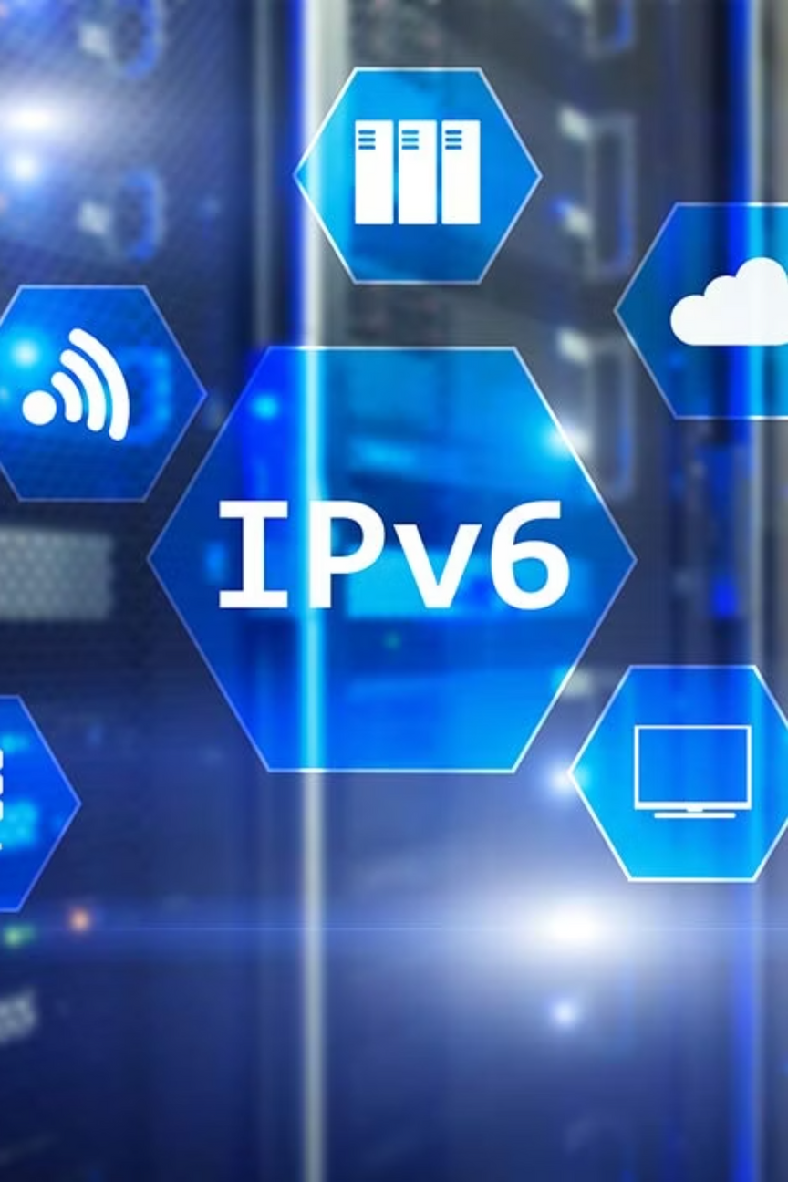
IPV6
By : Alan Saji

Slide 2
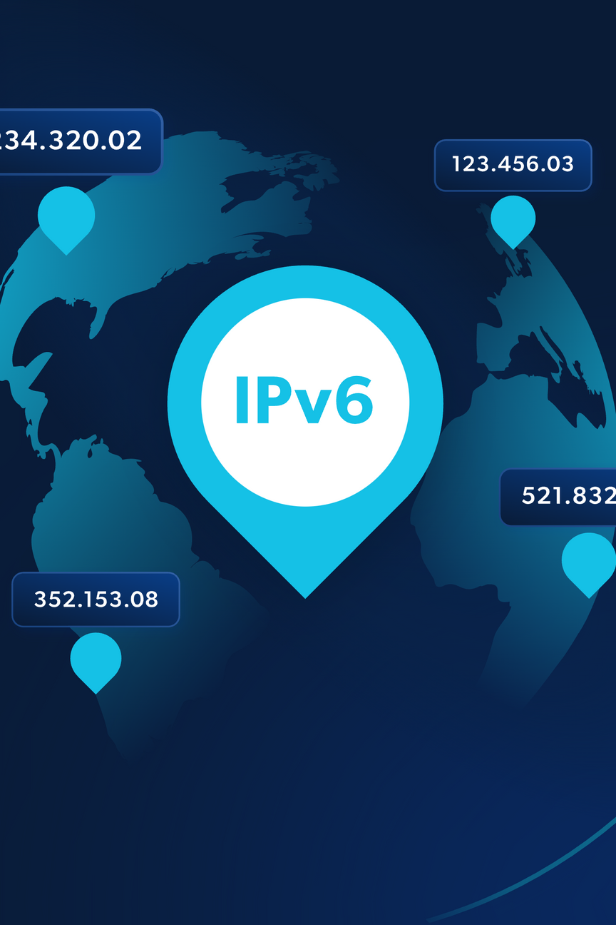

Introduction to IP
IP (Internet Protocol) is used to identify devices and enable communication on a network.
Two versions of IP exist:
IPv4 (Internet Protocol version 4) – older, limited addresses (32-bit).
IPv6 (Internet Protocol version 6) – latest version, designed to replace IPv4.
IPv6 provides more address space, better security, and modern features.

Slide 3
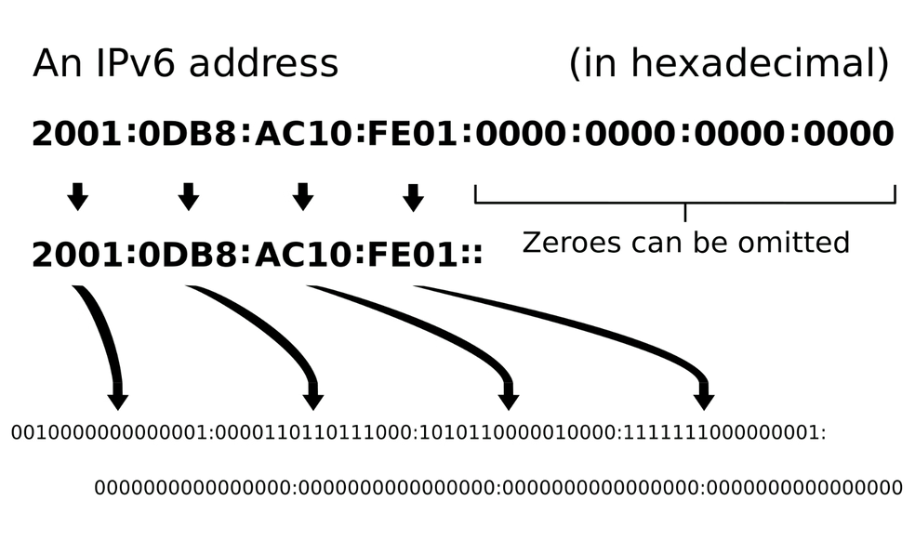
What is IPv6?
IPv6 = Internet Protocol version 6.
It is a network layer protocol that allows devices to communicate over the internet.
Uses 128-bit addressing, compared to IPv4’s 32-bit.
Written in hexadecimal format, separated by colons (:).
Example
2001:0db8:85a3:0000:0000:8a2e:0370:7334.
Provides 3.4 × 10³⁸ unique addresses → practically unlimited.

Slide 4
Abbreviation Rules in IPv6
IPv6 addresses are long, but rules make them shorter:
1. Remove leading zeros in each block.
2. Replace consecutive zero blocks with ::.
Example: 0074 → 74, 000F → F.
Example: 2001:0db8:0000:0000:0000:0000:0370:7334 → 2001:0db8::0370:7334.
Note: The shortcut :: can be used only once in an address.

Slide 5



Addressing Methods in IPv6
IPv6 supports three addressing methods:
Unicast
Multicast
Anycast
One-to-One communication.
One-to-Many communication.
One-to-Nearest communication.
Each method is designed for different communication needs.

Slide 6

Unicast Address
A unicast address refers to a single host.
When a computer wants to communicate with one destination, it uses a unicast address.
Used for one-to-one communication.
Examples:
Sending an email to one person.
Accessing a website hosted on a single server.

Slide 7
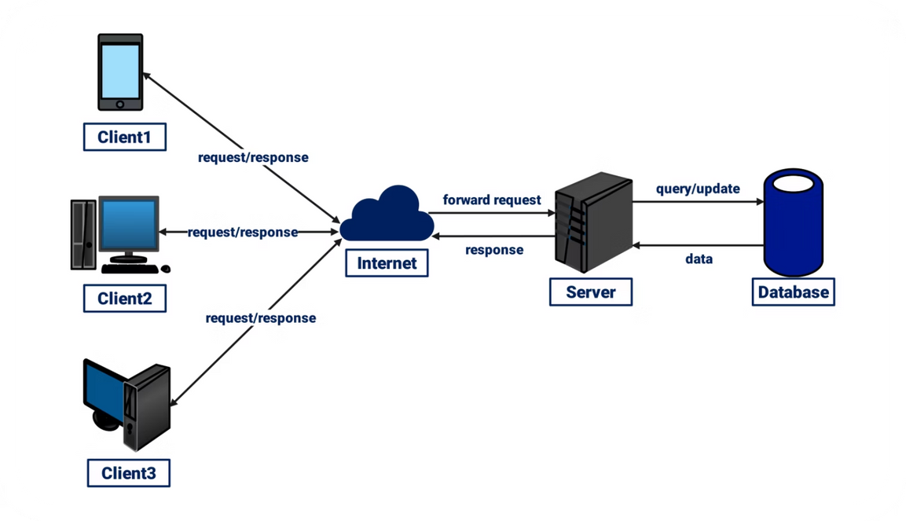
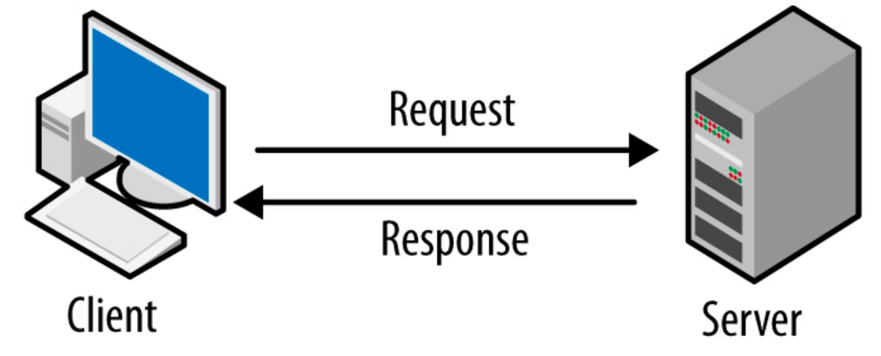
Multicast & Anycast Addresses
Multicast:
Anycast:
Used when a source needs to send data to a group of hosts.
Assigned to multiple devices or servers.
A single packet is delivered to all members of the group.
Packet is delivered to the nearest device (shortest path).
Example: Online video conference or live streaming.
Commonly used by ISPs for load balancing.
Relationship: One-to-Many.
Relationship: One-to-Nearest.

Slide 8
Advantages and Disadvantages of IPv6
Advantages:
Disadvantages:
Stronger Security: Built-in IPSec provides encryption, authentication, and data integrity.
Transition Issues: IPv4 and IPv6 are not directly compatible.
Huge Address Space: Solves IPv4 exhaustion.
Conversion takes time due to widespread IPv4 usage.
Better Performance: Simplified headers, improved routing.
Implementation Cost: Upgrading devices and software requires investment.
End-to-End Communication: No need for NAT (Network Address Translation).

Slide 9
Thank You

